Slide 1
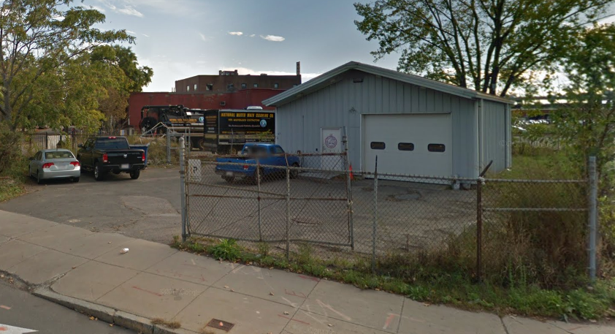
Developer’s Presentation to the Community:
BPDA-owned land located at:
516R 522 Main Street, Charlestown
AKA “EMS Site”
6:00 to 7:30 PM Thursday, September 30, 2021

Slide 2
Zoom Meeting Process…
Attendees may participate via the chat feature, as well as by using the “Raise Hand” function of Zoom. When you hit the “Raise Hand” button a staff moderator will know to unmute your computer. Please be mindful of background noise.
During the presentation, attendees will be able to submit comments and questions to the host via the chat. We’ll address questions after the presentation.

Slide 3




Zoom Tips! Welcome! tips for first-time Zoom Users.
The controls are located at the bottom of your screen.
Use the chat to type a comment or ask a question at any time –
BPDA staff will moderate the chat
To raise your hand, click on “Participants” at the bottom of your
screen, and then choose the “Raise Hand” option in the participant box
Mute/unmute – Participants will be muted during the presentation –
the host will unmute you during discussion if you raise your hand and
it is your turn to talk
Turns your video on/off

Slide 4
1
Introductions & Purpose

Slide 5
Purpose of Tonight:
Hear a presentation from the responding developer to the RFP for the BPDA EMS site;
Give the community an opportunity to ask the development team questions &
Begin comment period for community members to provide feedback to the BPDA on moving forward with this development team

Slide 6
Agenda
Introductions & Purpose
The Site & RFP
Presentation by the Proposed Development Team
Community Feedback
Next Steps

Slide 7
2
The Site & RFP

Slide 8
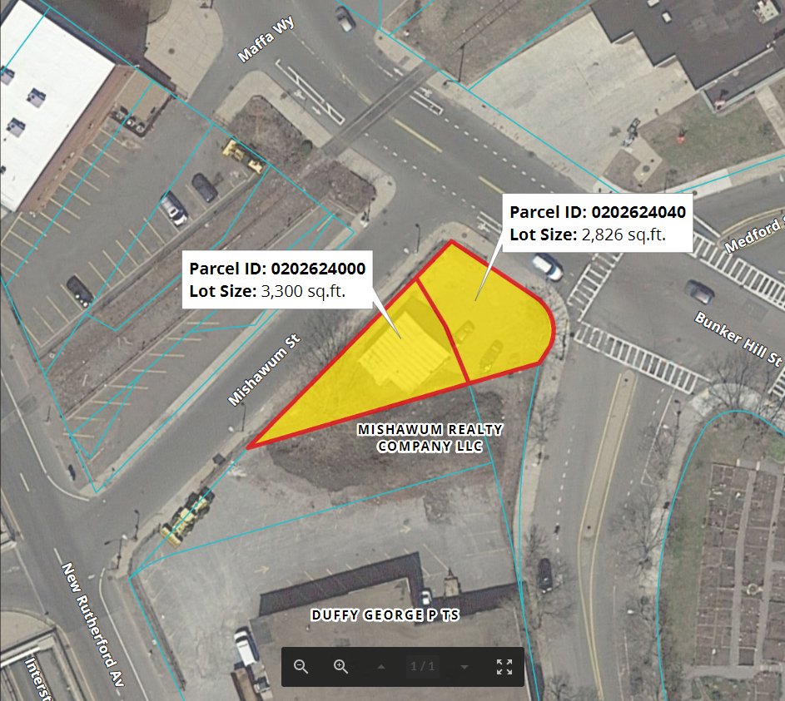
516R 522 Main Street
BPDA-owned site --
~6,126 square feet, contains panelized metal building - Charlestown EMS substation. Licensed to EMS since 1992.
Charlestown Urban Renewal Area, Project Mass. R-55, Portion of Parcel C-7.
Zoning : Charlestown Neighborhood district (Article 62),
Map 2E / NS (Neighborhood Shopping) sub-district ( allows commercial / retail / shopping );
Overlays: None /Other Layers: FEMA Flood Zone, Parks Design Review.
Notes:
Corner of Lenox and Tremont Streets, next to a recently renovated 9 unit building. Has been licensed to the church for parking since February 2007.

Slide 9
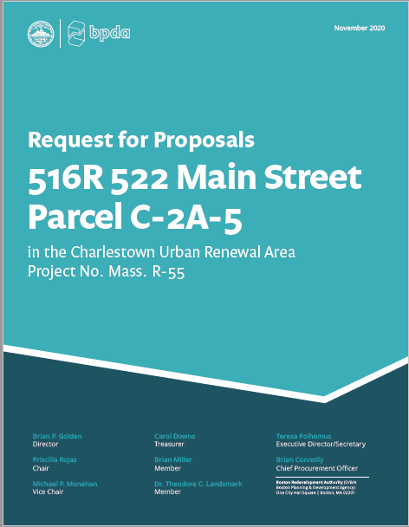
Community Process
Community meeting 03/12/19 at Schrafft’s Center, followed by a public comment period – BPDA received strong support to move ahead with RFP.
  Community members emphasized opportunity for a public-private partnership to recapitalize and expand the EMS presence in Charlestown

Slide 10
RFP Development Guidelines & Objectives
Establish and create a permanent home for the Charlestown EMS substation through a public-private partnership; replace existing temporary structure with state-of-the-art, two-bay modern facility as part of a mixed-use development.
Redevelop an underutilized and potentially blighted property with a project that enhances the neighborhood, provides jobs and economic development, and promotes transit-oriented growth.
Ensure development in this area addresses flooding and climate resiliency.
Provide an opportunity for increasing the supply and accessibility of housing in Charlestown.
Incorporation of adjacent private land into the project is allowed.

Slide 11
Community Driven Public Real Estate Development Process
Phase 1: Project Planning
What do we as a City and a Community want to do with this property?
Project Planning
Phase 2: Developer Selection
Who do we want to work with to redevelop the property?
Beginning this step tonight
Developer
Selection
Phase 3: Design and Permitting (Article 80)
How does the development fit within the existing context and how can it be improved? What mitigations and community benefits should the development produce? What permits and approvals are required?
Development Design and Permitting
Notes:
Presenter's Name
11

Slide 12
Public Real Estate Development Process
Initial Community Meeting
3/12/19
First RFP Issued
2/19/20
Second RFP Issued
11/25/20
Project Planning
Community Comment & Feedback
BPDA cancels several projects due to insufficient diversity and inclusion commitments
Tentative Developer Selection by BPDA Board
Developer Presentation to Community
TONIGHT
RFP Responses Received
6/16/21
Developer
Selection
Community Comment & Feedback
Article 80 Filing
Community and IAG Meetings to refine development
Public Approval Processes (e.g., Design, Zoning, BPDA Board)
Final BPDA Approval and Construction Start
Development Design and Permitting
Community Comment & Feedback
Community Comment & Feedback
Community Comment & Feedback
Notes:
Presenter's Name
12

Slide 13
4
Developer Presentation of Proposed Project

